Slide 1

LogoType
Fund Me

Slide 2

Team Members:
Hakeem Al Abbasi.
Ibtehal Fahd.
Mohammed Azman.
Thuraya Abdullah.

Slide 3
01
What is the idea of Our Project
02
Technical Analysis
03
Work on Github
04
Structure
05
UI & UX
User interface and user experience

Slide 4
Why Fund me!

Slide 5
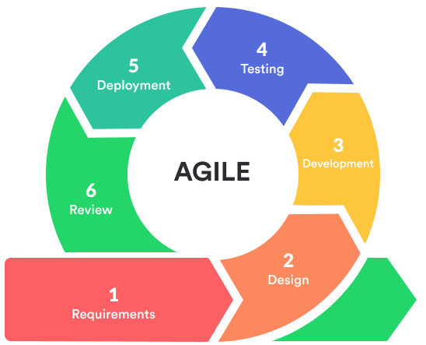
Technical Analysis
Agile Methodology
01

Slide 6
Technical Analysis
02
Sprints
Sprint One
Sprint Tow
Sprint Three
Authentication
View profile
Manage user
Add campaign
Manage campaign
Notification
View campaign Details
Manage Comments
User manage campaign
View Other Profile
Forgot Password
Multi Language
Reports
Search
Manage profile
Tags

Slide 7
Technologies used
MVC PHP
Html 5
Ajax
Technologies
JS
My SQL
Css3

Slide 8
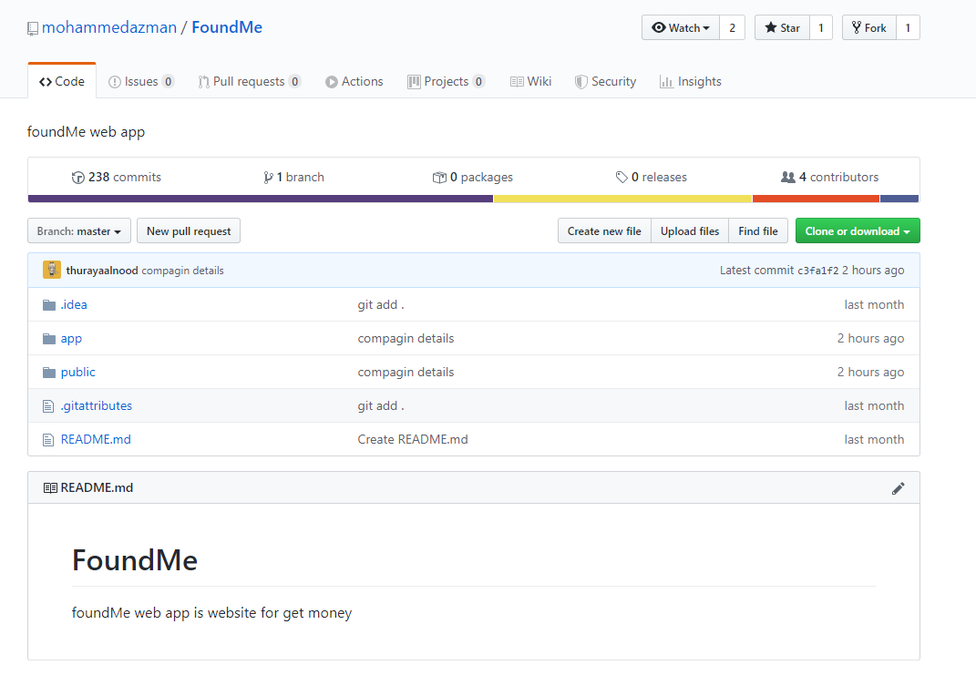
GitHub

Slide 9
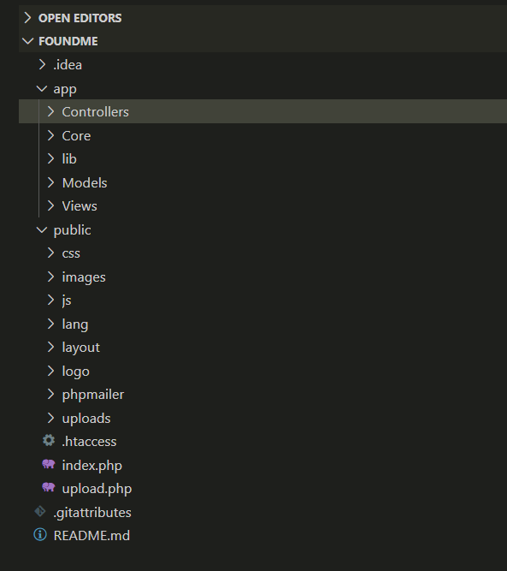
Structure
Controllers
Views
Models

Slide 10


UI & UX

Slide 11
Website Demo

Slide 12
LogoType
Thank You

